Slide 1

Skin Cancer(malign moles) Detection Using Deep Learning
B. Tech, Major Project Presentation
April 2018
Submitted By: Submitted To:
Md Soharab Ansari Mr. Nishant Kumar
Abhishek Shukla (Asst. Professor)
Jagmohan Yadav Cse, Dept.
Harshit Bajpai

Slide 2

Contents:
Introduction
Need of Skin Cancer Detection
Software package used
Functional Block Diagram of the project
Dataset Used
Methodology
Challenges
Applications

Slide 3

Introduction:
Melanoma, also known as malignant melanoma, is a type of cancer that form the pigment-containing cells known as melanocytes. Melanomas typically occur in the skin, but may rarely occur in the mouth, intestines, or eye. In women, they most commonly occur on the legs, while in men they are most common on back. Sometimes they develop from a mole with concerning changes including an increase in size, irregular edges, change in color, itchiness, or skin breakdown.

Slide 4

Need of Skin Cancer Detection???
Skin cancer is a common disease that affect a big amount of peoples. Some facts about skin cancer:
Every year there are more new cases of skin cancer than the combined incidence of cancers of the breast, prostate, lung and colon.
An estimated 87,110 new cases of invasive melanoma will be diagnosed in the U.S. in 2017.
The estimated 5-year survival rate for patients whose melanoma is detected early is about 98 percent
in the U.S. The survival rate falls to 62 percent when the disease reaches the lymph nodes, and 18 percent when the disease metastasizes to distant organs.

Slide 5

Objective:
The purpose of this project is to create a tool that considering the image of a mole, it can calculate the probability that a mole can be malign. The idea of this project is to construct a CNN model that can predict the probability that a specific mole can be malign.

Slide 6
Software Package used:
Tensorflow
keras
Python

Slide 7
Functional Block Diagram of the project :

Slide 8
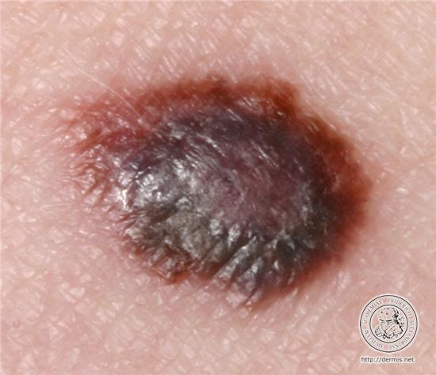
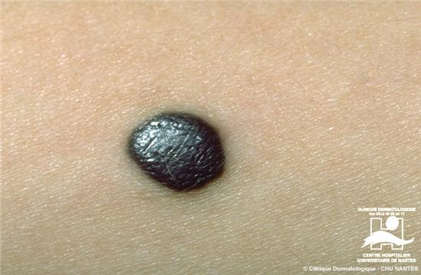
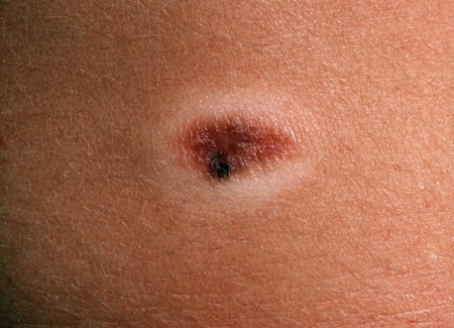
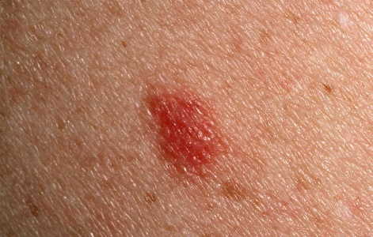
Dataset Used:-
Melanoma: Notmelanoma
Dermis
Dermis
Dermquest
Dermquest

Slide 9
Proposed Approach(Convolutional Neural Network) :
The idea is to develop a simple CNN model from scratch, and evaluate the performance to set a baseline.
The following steps to improve the model are:
1. Data augmentation: Rotations, noising, scaling to avoid over fitting.
2. Transferred Learning: Using a pre-trained network construct some additional layer at the end

Slide 10
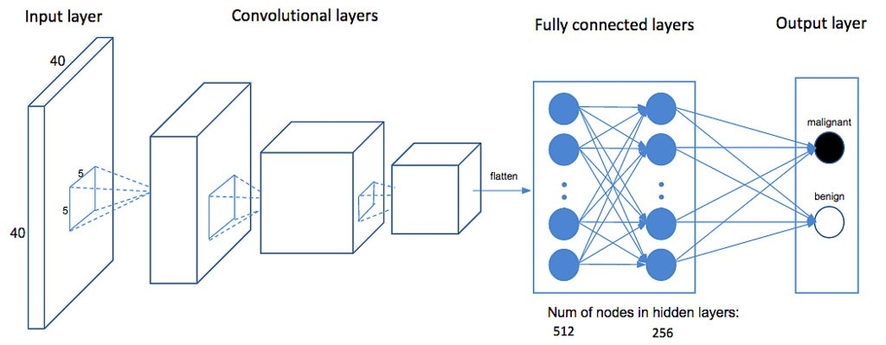
convolutional Max pooling flatten
layer layer layer

Slide 11
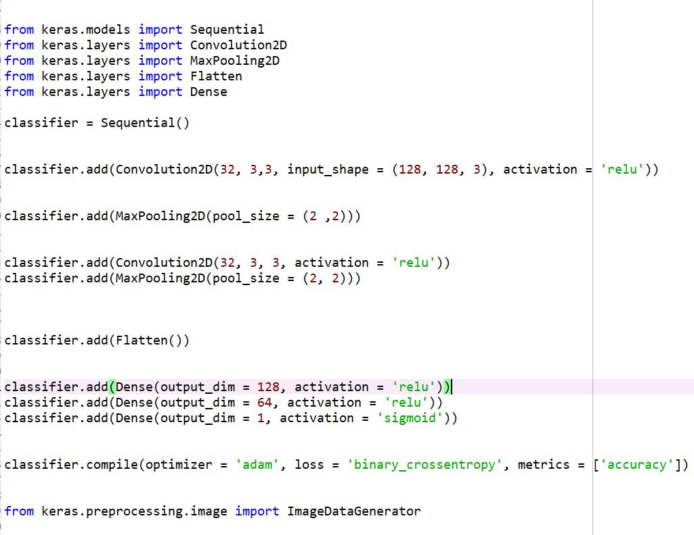
Code :-

Slide 12
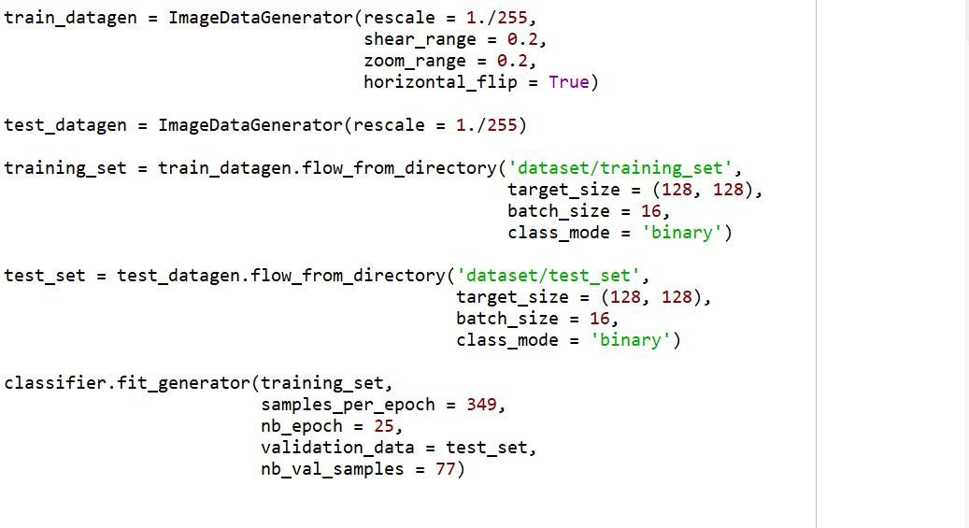

Slide 13
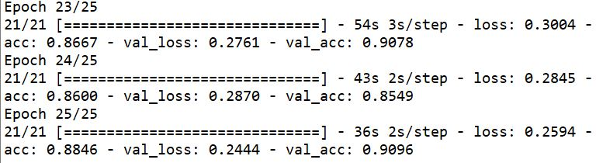
RESULT :- Accuracy

Slide 14
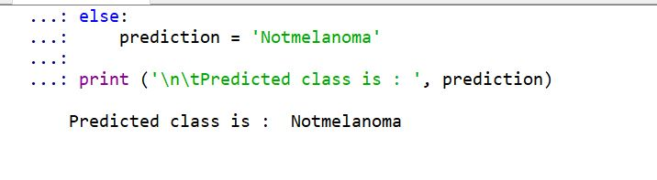
Prediction :-

Slide 15
Challenges:
The images of moles had to be downloaded from internet.
The project code algorithms need to be optimized with quality of results to be consistent.
Operating code over 400 images is time consuming because each image has many attributes to be calculated and stored.
CNN implementation is also needed to get a higher accuracy in results.
Any large dataset can be trained but skin cancer detection is tough when mole is small enough to come in picture or take images will decrease accuracy of algorithms used.
Heterogeneous database may not still be sufficient unless every type of culture, tradition, and environment is fed into neural network which is practically difficult to implement.

Slide 16
Applications:
This project finds great application in the medical field, in medical field as it can easily detect the skin cancer which a patient has and diagnose it with the help of doctors and doctors and patient can upload skin cancer images taken during diagnosis to the system from anywhere, and obtain a recognition result by a cellular-phone e-mail. As future work, we plan to return the full detail of that skin cancer and some medical advices on the skin cancer.

Slide 17


